Slide 1
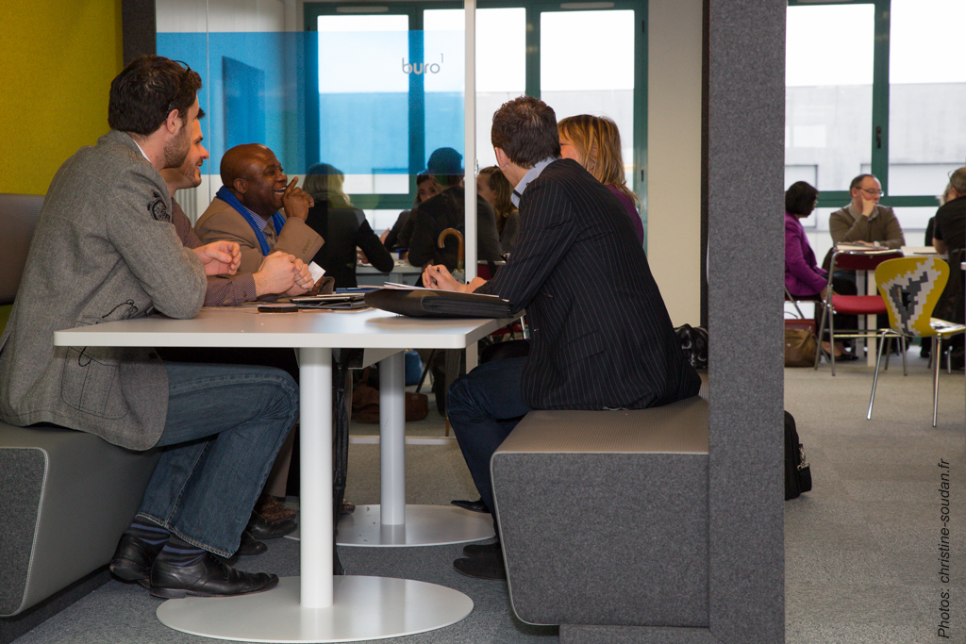
FLEXIBLE TIME

Slide 2
THE VARIOUS FORMS OF FLEXIBLE ARRANGEMENTS

Slide 4
What is full timing?
- Around 35 to 40-hour work week altogether
Concerns more than ¾ of offices
Main Advantages : for employees : full time salary and benefits guaranteed , offers safety
and more professional career opportunities.
for employers : fixed schedules are easier to plane

Slide 5
What is part timing ?
Part-time workers work fewer hours (15 to 30 per week) than full time workers.
Main Advantages : Fewer hours at work mean more time with family and better work life balance, lighter workload
Main Disadvantages : Employees want to do more in less time, they are stressed. Lower income. Fewer career opportunities.

Slide 8
job sharing
Job sharing is a work arrangement in which two people work part-time and share the responsibilities of one full-time job.
Main Advantages : For employers : Possibility to retain talented workers who want flexible working arrangements, two skilled workers instead of one
For employees : Less stress, more motivation
Main disadvantages : For employers : can be more costly, not productive if both employees are not able to collaborate.
For employees : Can lead to failure and stress if both employees can’t work in collaboration.

Slide 9
Compressed scheduling
It offers employees the opportunity to work the equivalent of a standard workweek in fewer than the usual number of days. (Working 4 days instead of 5 for example)
Main Advantages : Employees can enjoy one full day off work, save on petrol
Main disadvantages : Employees work more hours the rest of the week, it can be tiring and stressful.

Slide 10
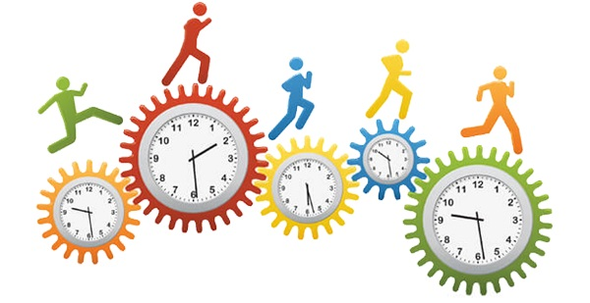

Slide 11
What is flextiming ?
Flexitime is an arrangement where an organisation gives its employees the opportunity of a flexible working hours arrangement and flexible locations.
Staff can choose when they work, on condition that they achieve their total daily, weekly or monthly hours.
Main Advantages : More time with family, full-time salary as long as the task is completed, less stress because of fixed working hours.
Main disadvantages : Less focus on work, likely to affect efficiency

Slide 13
Working from home
ADVANTAGES FROM WORKING FROM HOME:
-It’s nice to stay home
-Employees are close to their family and share important moments such as mealtimes
-It allows employees to work autonomously and to be responsible
-It is more environmentally friendly because employees don’t have to commute
-It offers more freedom : employees can organize their own schedules
-They save costs on fuel, and spend less time in transports (are less stressed)
DISADVANTAGES FROM WORKING HOME:
-It is easy to get distracted by things which are going on around you.
-Employees may feel lonely and need the contact distance with their colleagues
-Exchange between colleagues is limited
-It is sometimes difficult to find an adequate and isolated workspace
-It is also difficult to set up an independent telephone line
-Employees must have ADSL.

Slide 14
TO SUM UP …
Flexible time generally offers a better balance between private life and professional and better productivity at work,
But …
Conflicts between employees are frequent because it is difficult for employers to choose what employee they will grant flexitime to. Also flexible schedules require reorganizing the working hours of all employees within the company. This can be time consuming.

Slide 15
Nourou Saindou
Marina Fayol
Kenzy Honorine
Ophélie Reboul
Guillaume Aboukir
Johana Hoarau
BTS AM1 – Lycée Antoine Roussin

